Slide 1
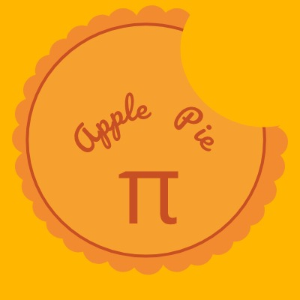
Team APPLE PIE
Tic Tac Toe
Ahmed Mahmoud Mohamed
Ahmed Mohamed Nassar
Mazen Amr
Kareem Osama
Muhamed Ayman
Muhammad Sayed

Slide 2
Outline
Evolution of tic-tac-toe
Variations of tic-tac-toe
Matrix tic-tac-toe
Game Theory Approach
Circular tic-tac-toe
Work And Results
Conclusion

Slide 3
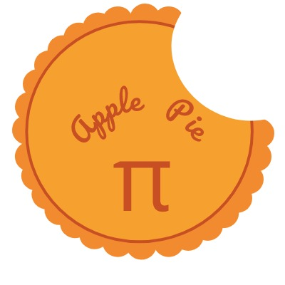
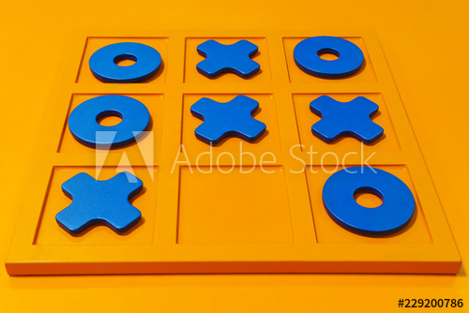
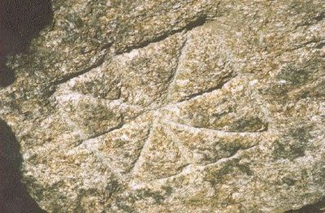
A Very Ancient Game
Evolution of Tic-Tac-Toe
Modern Tic Tac Toe
-Played by Romans and ancient Egyptians
-Very simple rules

Slide 4
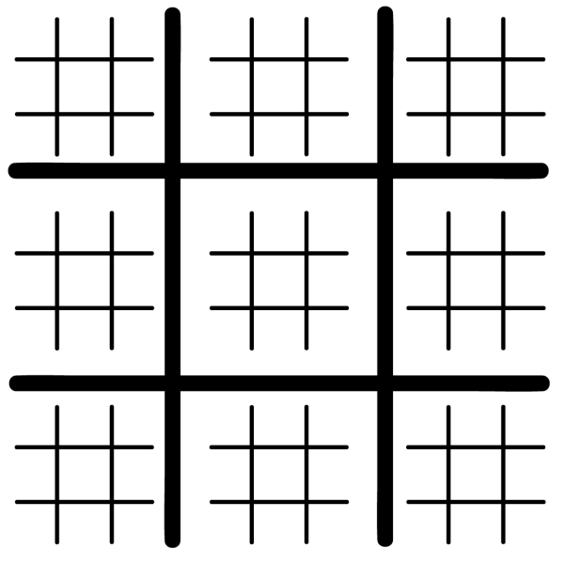
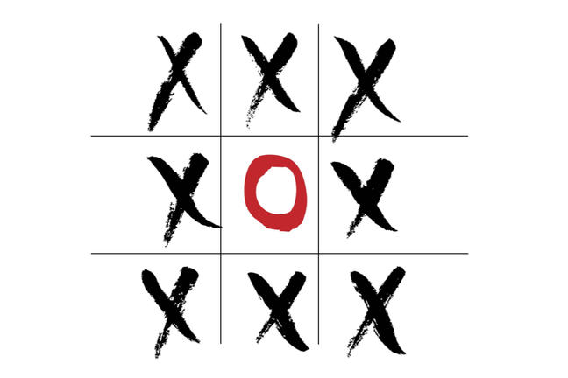
Variations of Tic-Tac-Toe
Ultimate tic-tac-toe
Wild tic-tac-toe
Ultimate tic-tac-toe
Wild tic tac toe
-A more complex version of tic-tac-toe
-More Challenging

Slide 5
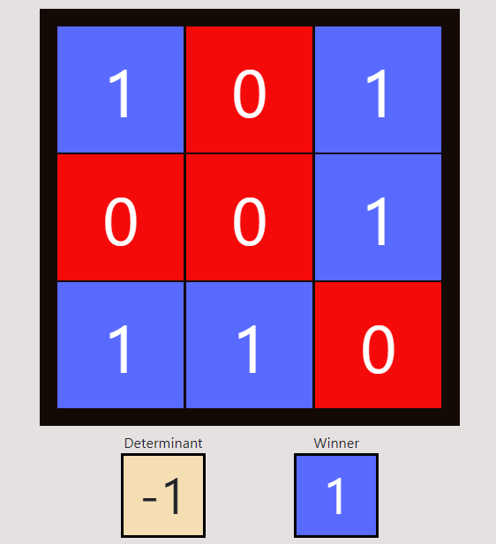
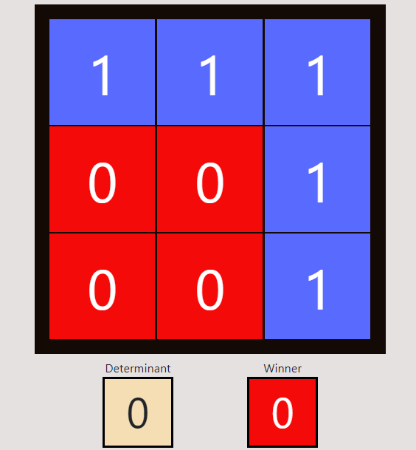
Matrix tic-tac-toe
Player 1 wins as the determinant of the resultant matrix is not zero (matrix is invertible)
Player 0 wins as the determinant of the resultant matrix is zero (matrix is singular).

Slide 6
Solving tic-tac-toe
-Game Theory Approach
-Circular tic-tac-toe

Slide 7
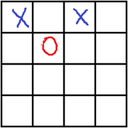
  Game Theory Approach
Disadvantages of Game
theory
Main Idea
trying to play all the valid moves, then try to find a move that when the game proceed it makes you in a winning state and the opponent in a losing state. If you haven’t found such a winning move then try to lead the game to the draw. If you can’t then no escape from lose.
Complicated implementation
high complexity in comparison
Not applicable for bigger sizes

Slide 8
Circular Tic Tac Toe
28
27
20
19
12
11
26
29
21
18
Circular tic tac toe is played on a circular board that has been divided in a natural way into 32 squares. Players alternate turns in which they may place a piece at any unoccupied square.
13
4
3
10
5
2
6
1
14
7
0
9
22
17
30
15
8
25
23
16
31
24

Slide 9
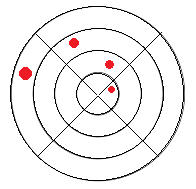
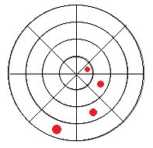
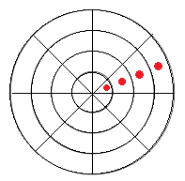
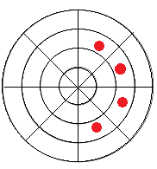
Circular Tic Tac Toe Winning Cases
Spiral to the left
Spiral to the right
Line from the center
Half Ring

Slide 10
Algorithm
Simply, There are 56 wining cases (32 half ring, 8 lines, 16 spirals) and for each cell, it contributes in some of them. The game state is represented by an array of 56 elements, for each play in a cell, we add/subtract according to the player type the contribution of that cell from the game state and we give each play a score (positive or negative) according to the effect that cell do in the game(will it lead to win or loss?), and finally we try to maximize the score.

Slide 11
Computer VS Computer results
Number of wins out of 10000 games:
Without any trap check | With half ring trap check | With half ring trap check and spiral trap check | With line-ring, ring-spiral and line-spiral trap check
Player 1: 9012 Player 2: 987 Draw: 1 | Player 1: 8261 Player 2: 1715 Draw: 24 | Player 1: 8186 Player 2: 1655 Draw: 159 | Player 1: 652 Player 2: 312 Draw: 9036

Slide 12
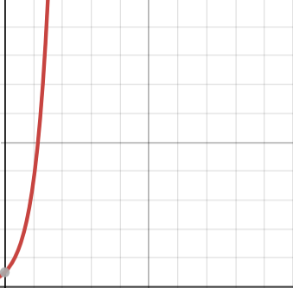
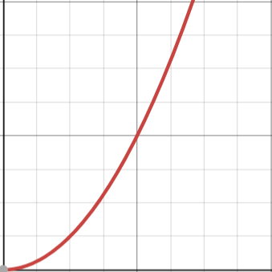
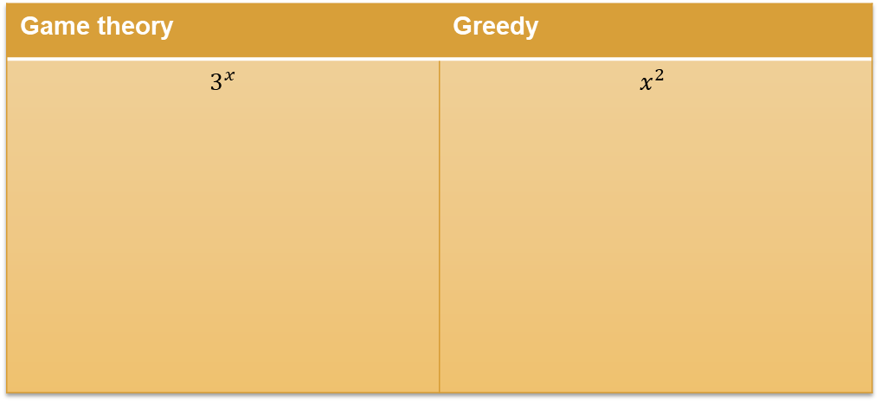
Game theory complexity vs greedy complexity
Game theory | Greedy
$$3^{x}$$ | $$x^{2}$$

Slide 13
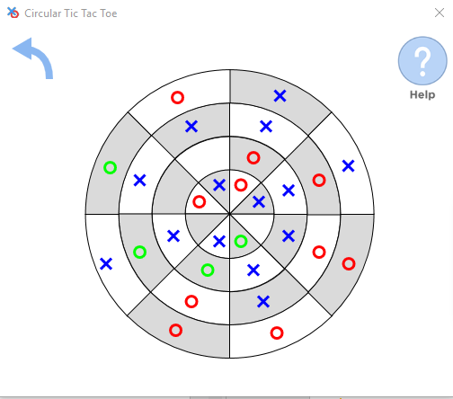
Our Program

Slide 14
Conclusion
To sum up, tic-tac-toe is not just a simple game that is drawn on 3x3 board as we thought but it also has many different ways (algorithms) to be played with.
we have discovered how to solve tic-tac-toe using linear algebra and how it helped us to reduce the complexity of the algorithm related to the complexity of the game theory.

Slide 15
Thanks!
Any questions?

